Slide 1
Microsoft RemoteFX GPU Virtualization Technology Deep Dive
VIR313
Karthik Lakshminarayanan
Group Program Manager
Microsoft

Slide 2
Objectives and Agenda
Objectives
Agenda
What is RemoteFX – Value proposition
How it works – Architecture
RemoteFX and the space
Background and Demo
Architecture on server and client
Technology deep dive for VDI and RDSH
USB Redirection with RemoteFX for VDI
RDP 7.1 client side architecture
RemoteFX Thin clients
2
Notes:
Today’s talk will cover the value proposition and will have a demo. Then we will do a deep dive on the architecture and how each component works to deliver this great end user experience.

Slide 3
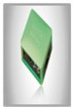

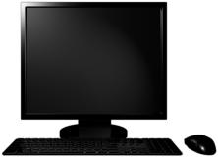

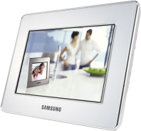
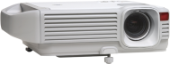
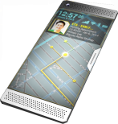
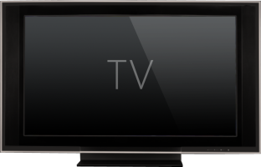
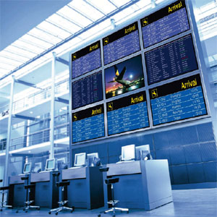
RemoteFX Clients
Windows Server & RemoteFX
Traditional PC
HTML 5
Windows Server & RemoteFX
Traditional PC
Requires a local IT Pro.
Manageable from anywhere.
Powerful
Microsoft Silverlight
Consumes ~170W.
Power footprint is shared.
Flexible
DirectX Apps
Cannot meet certain regulatory reqs.
Windows Media
Diverse
Helps meet regulatory reqs.
Vulnerable to hardware failures.
Aero Glass
Versatile
Recoverable from hardware failures.
Adobe Flash
Limited to PC form factors.
Enables full range of client form factors.
Portable
3
Notes:
When you talk about the desktop, you have to begin with the traditional PC. The PC has many advantages – it is a powerful device that runs a wide variety of applications, and is flexible - for offline and mobile scenarios, the PC is tough to beat. But it also has some drawbacks. For example, it requires a fair amount of power, it needs a local IT Pro to troubleshoot and maintain it. And if you have strict regulatory or compliance requirements, could be lot harder to implement. So traditionally, we have moved the desktops to the datacenter and ran it on a server. This has many advantages – until recently, most of these advantages were largely for the IT Pro. The user experience is average. As Windows 7 adoption grows and new web technologies like HTML5 evolve, providing a rich user experience will become a requirement. Modern browsers like IE9, FF4 and Chrome provide GPU acceleration – so GPUs are being used for web applications as well.
We want to enable a wider spectrum of thin client and zero client devices, so that managing these end point devices does not become a problem for the IT Pro. With RemoteFX, we can enable the full spectrum of client devices including a deployment that is just a keyboard, mouse, monitor and network.
With RemoteFX, VDI can be a win-win for the IT Pro AND the end user. Let’s look at a demo.

Slide 4
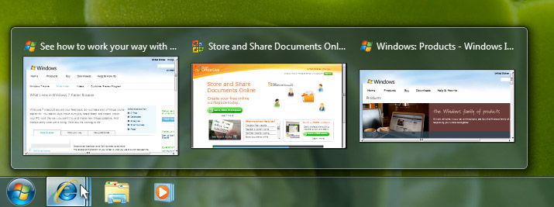
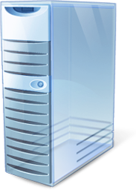
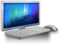
Demo – RemoteFX In Action
VDI user
IT Pro Admin
4
Notes:
Key talking points: full desktop experience, all delivered to a wide range of client devices including hardware based clients. You can deploy RemoteFX with entirely commodity hardware. Pass the 2 client devices around.
Media Center – Chess, Interactivity
Silverlight puzzle
Flip 3D
IE9 – Canvas demo
Demo – Device manager – do at the end

Slide 5
Agenda
RemoteFX and the space
Value Proposition and Demo
Architecture on server and client
Technology deep dive for VDI and RDSH
USB Redirection with RemoteFX for VDI
RDP 7.1 client side architecture
RemoteFX Thin clients
5

Slide 6
New Concept for RDP 7.1
RDP Client Rendering
RDP Host Rendering
Separate host intercept for each graphics stack & client equivalents – gaps
Single intercept point for all graphics – predictable and complete UX
Leverages Rich Client HW and SW
Lightweight Clients & Complexity Shifted to Host
Can lead to better bandwidth utilization for intercepted graphics types
Typically requires more bandwidth as traffic is sent as compressed bitmaps
6
Notes:
RDP 7.1 is the version that supports RemoteFX. We have changed the paradigm for RemoteFX, moving away from a client rendering model to a host rendering model. Specifically, client rendering is when the native content is intercepted and transmitted to the RDP client for rendering. In the host rendering model, all the content is rendered on the server and transmitted as bitmaps. So let us see how these compare:

Slide 7



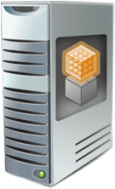
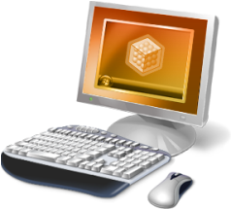



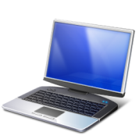
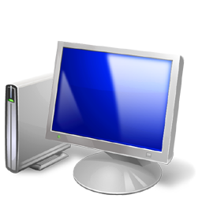
RemoteFX VDI Architecture Concepts
Enabling Technology
Customer Value
Differentiating Innovation
Full rich Windows experience
Content and GPU independent intercept & rendering
Single GPU for multiple Hyper-V guests
vGPU
Remoting any content
Applications run at full-speed on host
Host side rendering
Screen deltas sent to client based on network and client availability
High fidelity user experience
Intelligent screen capture and hardware-based encode
CODEC designed for text and image content
Single CODEC for VDI, RDS and WMS sessions
HW and software manifestations interoperable by design
Full range of client devices
Bitmap remoting and hardware-based decode
Supports all USB devices.
Redirection over RDP.
No client side drivers needed.
Full range of
USB devices
USB Device Redirection
Notes:
USB redirection
Allows you to redirect virtually any USB device transparently over RDP
Redirects devices at the USB Request Block (URB) Level
No client drivers necessary
One method that works with many devices
Only one session can use a USB device at a time
Optimized for the LAN
The Virtualized Graphics device technology enables the knowledge worker to run all graphical (2D and 3D) applications in a virtual machine, and it allows the IT admin to share a physical graphics device(s) across multiple knowledge workers in a graphics device agnostic fashion. The same VGPU driver will work irrespective of whether the underlying hardware is from NVIDIA, ATI, or any other vendor.
Remote any content – Host side rendering
Existing RDP technologies are based on primitive remoting and client side rendering. With the Calista release, the RDP Server will now support server side rendering, where the entire desktop screen is composed on the server. Applications will use the VGPU like any other graphics device, just like they do on a local PC. With this approach, the system no longer has to be updated for the next popular graphics format in the industry.
High fidelity UX – Intelligent screen capture and hardware based encode.
The primary goal for Calista is to deliver the local desktop like experience from the server to any client. Once the desktop screen is rendered on the host, the Calista system has effectively flattened the desktop content to a 2D bitmap. The system has an intelligent capture mechanism which can detect what changes between successive rendered bitmaps and pick and choose content based on the network condition. These changes are then compressed using the processing power of the GPU and the CPU.
The system also has an hardware implementation of the codec. This allows the VDI server to deliver a constant screen frame rate independent of the user workload, increases the user density per server, when compared to the software approach..
Any range of client devices – Bitmap remoting and hardware based decode
This standardization of the content to a bitmap enables any basic display client to consume this content. As long as a client display device has a basic 2D display engine, it will be able to render this 2D bitmap. There is no need of sophisticated graphics stack on the client. This piece of technology is absolutely game changing, as it enables the customer to get his full rich Windows experience not just on PCs but on any device with a display. We are working with hardware partners to integrate the codec chip into their devices, like LCD TVs, monitors, phones, handhelds, etc.

Slide 8
Hyper-V VDI + RemoteFX Components
WS08 R2 SP1 Hyper-V Server
Inter-VM Communications
Hyper-V Parent Partition
Hyper-V
Integrated Shared Memory
Comms
RDP
Protocol Fundamentals (e.g. Authn, Encryption)
W7 SP1 Guest OS
VGPU output rendered to physical GPU via DirectX.
Screen deltas captured from GPU.
First phase of CODEC runs on GPU.
vGPU (WDDM) driver exposes parent GPU to guest OS.
RCC
VGPU Driver
VMBUS
GPU
RemoteFX Hardware ASIC and Driver
Optionally offloads CODEC from CPU/GPU increasing fidelity and scale.
8
Notes:
Lets look at how these components are integrated with Hyper-V and the server

Slide 9
RemoteFX-for-RDVH (VDI) Virtual GPU and Rendering Pipeline
RemoteFX Hyper-V VM Bus Parent Integration
IE9
Windows
App
RCC
Hyper-V VMBUS
Shared Memory
Comms
Hyper-V Parent Partition
DX9 APIs
GDI
W7 Child Partition
DX9 APIs
RemoteFX VGPU Driver
GPU Vendor Driver
RemoteFX Hyper-V VM Bus Child Integration
GPU
9

Slide 10
RemoteFX-for-RDVH (VDI) Capture and Encoding Pipeline
RemoteFX Hyper-V VM Bus Parent Integration
User Mode RDP
RDP
RCC
Hyper-V VMBUS
Shared Memory
Comms
Hyper-V Parent Partition
W7 Child Partition
DX10 APIs
RemoteFX VGPU Driver
GPU Vendor Driver
RemoteFX ASIC DRIVER
RemoteFX Hyper-V VM Bus Child Integration
GPU
RemoteFX ASIC
10

Slide 11
RemoteFX-for-RDSH (formerly TS)
Session 0
Session [1…n]
TS Core
IE
Office
Other
LSM
TERMSRV
RDPWSX
GDI
User
Windows Server with RDSH Enabled
Kernel
RDP Core
WIN32K.SYS
TERMDD
RDPWD
RDPDD (RDP Display Driver)
RemoteFX HW Encode Driver
RDP
TDTCP
RemoteFX Encode Library
CPU
RemoteFX Encode ASIC
Notes:
RDPWSX – DLL that contains user mode extensions for server
RDPWD – RDP Winstation Driver - (the driver that does all the RDP VC Multiplexing, connection sequence and protocol framing).
TDTCP – TCP Pipe – Transport Driver

Slide 12
RemoteFX for RDVH and RDSH – Cheat Sheet
 | RemoteFX for RDVH (VDI) | RemoteFX for RDSH (TS)
Hardware/Software Requirements
CPU with SLAT (SSE2 is a subset of SLAT) | X
CPU with SSE 2 | X | X
GPU installed in Host Server | X
Windows 7 SP1 virtual machine | X | NA
RDC 7.1 Client | X | X
Features/Benefits
GPU Virtualization | X
USB Redirection | X
Aero | X
RemoteFX Compression using software (CPU only for RDSH, CPU and GPU for VDI) | X | X
Offload RemoteFX CODEC to Hardware (Identical HW for TS and VDI) | X | X
12
Notes:
SSE2 = Streaming SIMD Extensions 2

Slide 13
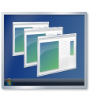
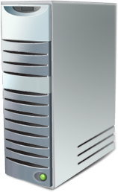

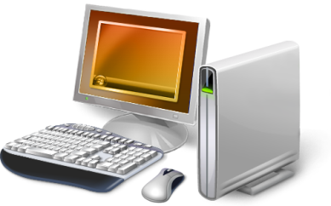
The RemoteFX ‘Payload’
RDSH (TS)
RDVH
RemoteFX
Remote Desktop Protocol (RDP)
RDS Server Infrastructure
RemoteFX-enabled RDS Server Infrastructure
RemoteFX-enabled Remote Client
Remote Client
RemoteFX leverages the RDP protocol structure
Graphics Virtual Channels (VCs)
Mouse & Keyboard VCs
Device
VCs
Partner Virtual Channel Plug-Ins
Virtual Channel Multiplexing and Framing
Bulk Compression (RDP5+, RDP6.0, RDP6.1)
Security Layer (SSL/Kerberos/NTLM)
Transport Layer (e.g. TCP, RPC/HTTP, Windows Live Tunnel)
13

Slide 14
RDP 7.1 Client Components and Graphics Pipeline
Core Services
Networking/
Security
Virtual Channels
Devices
Bulk Decompress
Key/Mouse
RDP 7 Graphics Providers (AERO, Windows Media)
RemoteFX Decode Abstraction Layer
RemoteFX SW Decoder
GPU
Display Device
RDP
RDP Client Components
CPU
RemoteFX HW Decode Driver
RemoteFX Decode ASIC
14

Slide 15
RemoteFX USB Device Redirection for VDI
Versatile
Rich and thin clients (no client drivers necessary)
Use with any RemoteFX-enabled VM
Admins control what devices can and cannot be redirected
Compatible
Works with just about any USB device
Applications are transparent to redirected devices
Integrate with PnP/Windows Update for device installs
15

Slide 16
Local USB Device Arrival (without RemoteFX)
Application
USB Device
Driver
4
User
Win32 I/O API
Kernel
Windows Kernel
(I/O Mgr, PnP)
3
2
USB HUB
Provided by:
1
Microsoft
IHV/ISV
Notes:
Make this slide before Device Claim

Slide 17
USB Redirection – RDP Client Side Behavior
RemoteFX VM on
RDVH Server
RDP Client
5
USB Device
Driver
RDP
User
Kernel
3
Remote FX Generic USB Driver
4
2
RemoteFX USB Hub Filter
Provided by:
Microsoft
USB HUB
1
IHV/ISV

Slide 18
USB Redirection – VM Behavior
RemoteFX VM on
RDVH Server
Application
USB Device
Driver
10
Win32 I/O
API
User
Kernel
Windows Kernel
(I/O Mgr, PnP)
9
6
RemoteFX Device Proxy
7
Provided by:
8
Microsoft
RemoteFX USB HUB
IHV/ISV
Notes:
Auto connect: we will not return a device to the client until all attempts will be completed
On the disconnect all redirected devices will be removed

Slide 19
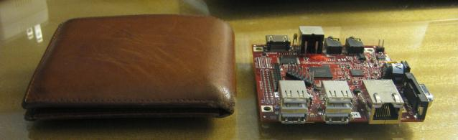
RemoteFX Ultra Lightweight Thin Clients
New class of Thin Client using ARM based designs
Works with Hyper-V VDI, RDSH and Multipoint Server
Running Windows CE, Linux, or in-house OS
Lower client resources
CPU: 200 – 400 MHz
Memory: < 256MB RAM, < 128MB Flash Memory
Less than 5w power
Dedicated CODEC for acceleration
19

Slide 20
RemoteFX Sizing Guide for VDI
Based on the display resolution and workload per VM, the following number of virtual machines could be loaded on a GPU
Can load additional non-RemoteFX VMs on the same server [e.g. HP RA has 65 non-RemoteFX VMs and 12 RemoteFX VMs on a 8 core server with a single 1.5 GB GPU]
* These are theoretical numbers of how many RemoteFX-enabled virtual desktops could fit on a GPU with given amount of video memory. They do not take into account the amount of GPU resources consumed by each virtual machine. The GPU resource consumption will vary from workload to workload. Actual numbers will vary based on the workloads executing in the virtual machines.
 | Maximum RemoteFX-enabled virtual desktops per GPU *
Resolution | 1 GB Nvidia FX3800 ATI V5800 | 1.5 GB Nvidia FX4800 | 2 GB ATI V7800 ATI V8800 | 4 GB Nvidia Quadro FX5800
1024x768 | 13 | 20 | 27 | 54
1280x1024 | 8 | 12 | 16 | 32
1600x1200 | 5 | 8 | 11 | 22
1920x1200 | 4 | 6 | 9 | 18
20

Slide 21



In Closing
Call to Action
Watch for latest news | Watch the RDS blog for latest: http://blogs.msdn.com/b/rds/ Keep up to date on latest partner offerings by visiting http://www.microsoft.com/remotefx Download the Step by Step and Conceptual documents.
Evaluate | Evaluate fit for your users and environment. Download RTM of SP1 and exercise your scenarios.
Share and give Feedback | Share and ask through the Web Forum: http://forums.technet.microsoft.com/en/winserverTS/threads/
Questions and Answer
21

Slide 22
Common Misconceptions About RemoteFX
The CAPEX of RemoteFX is higher because of GPUs.
The user density per server is lowered with RemoteFX.
RemoteFX scales to just a couple of VMs per GPU.
There are no RemoteFX ready servers in the market today from major server OEMs.
MS views RDSH as being of lower importance than VDI.
RemoteFX is for Aero only.

Slide 23

Track Resources
Don’t forget to visit the Cloud Power area within the TLC (Blue Section) to see product demos and speak with experts about the Server & Cloud Platform solutions that help drive your business forward.
You can also find the latest information about our products at the following links:
Cloud Power - http://www.microsoft.com/cloud/
Private Cloud - http://www.microsoft.com/privatecloud/
Windows Server - http://www.microsoft.com/windowsserver/
Windows Azure - http://www.microsoft.com/windowsazure/
Microsoft System Center - http://www.microsoft.com/systemcenter/
Microsoft Forefront - http://www.microsoft.com/forefront/

Slide 24





Resources
Connect. Share. Discuss.
http://northamerica.msteched.com
Learning
Sessions On-Demand & Community
Microsoft Certification & Training Resources
www.microsoft.com/teched
www.microsoft.com/learning
Resources for IT Professionals
Resources for Developers
http://microsoft.com/technet
http://microsoft.com/msdn

Slide 25
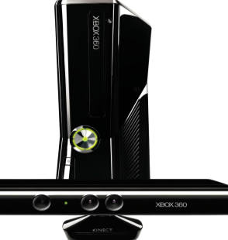
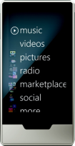
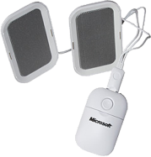
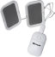
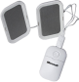







Complete an evaluation on CommNet and enter to win!

Slide 26

Notes:
New for TechEd 2011, we will be working with Microsoft Tag (http://tag.microsoft.com/overview.aspx) to create unique Tags for every session at the event. Your session Tag will appear on both the room signage and at the end of your presentation. With your session Tag, attendees will be able to scan as they enter the room to retrieve session details, view speaker bios, and engage in discussions; or scan at the end of the presentation to evaluate your session and download materials. We’re excited to integrate Microsoft Tag across the My TechEd mobile experience this year.

Slide 27

© 2011 Microsoft Corporation. All rights reserved. Microsoft, Windows, Windows Vista and other product names are or may be registered trademarks and/or trademarks in the U.S. and/or other countries.
The information herein is for informational purposes only and represents the current view of Microsoft Corporation as of the date of this presentation. Because Microsoft must respond to changing market conditions, it should not be interpreted to be a commitment on the part of Microsoft, and Microsoft cannot guarantee the accuracy of any information provided after the date of this presentation. MICROSOFT MAKES NO WARRANTIES, EXPRESS, IMPLIED OR STATUTORY, AS TO THE INFORMATION IN THIS PRESENTATION.

Slide 28
Industry Trends Leveraged By RemoteFX VDI
Infrastructure
VM isolation enables full desktop centralization
Processor evolution shifts from clock speed to massive parallelism
Faster networks
Increased diversity of client devices
Graphics related trends
Graphics Richness Increasing: HTML5, Media, 3D UI, Video, Animations, Flash, Silverlight
Increasing Fragmentation of Graphics Stacks
Portable Graphics stacks like Silverlight and Flash Emit as Flattened Bitmaps
Modern Browsers Leveraging GPUs where Available
28

Slide 29
Backup

Slide 30
RemoteFX OS & System Requirements for VDI
Hyper- V Host for VDI or RDSH
Windows Server 2008 R2 with SP1
(Hyper-V, Standard, Enterprise, and DataCenter editions)
VDI Virtual Machine
Windows 7 Enterprise with SP1
Windows 7 Ultimate with SP1
Remote Client Device [works with VDI, RDSH or Multipoint Server]
Windows 7 with SP1
Devices with RDP 7.1
30

Slide 31
RemoteFX Requirements for RDSH
Requires Windows Server 2008 R2 Service Pack 1.
To use RemoteFX on an RD Session Host server, the processor on the RD Session Host server must support Streaming SIMD Extensions 2 (SSE2).
The RDSH role with RemoteFX can run as a virtualized workload on any hypervisor, since there is no dependency on a GPU.
Off by default. Enabled via a Group Policy
Recommended if your users will ever run any Flash, Silverlight or HTML5 content
31

